Slide 1
Mutual Fund Performance And Risk Analytics Dashboard
Analysing AUM, Returns, Risk, Cost & Fund Performance using Power BI
Name : Challa Harika
Batch : DA/BA Batch
Code : Python, Power BI, DAX, Excel

Slide 2
Business Problem :
Investors and fund management teams need to evaluate mutual funds across multiple dimensions such as AUM, returns, risk, expense ratio and risk-adjusted performance. Looking at individual metrics makes it difficult to identify strong-performing categories, AMCs, managers and schemes.
Business Objective
The main objective is to evaluate mutual funds using multiple performance and risk factors and build an interactive Power BI dashboard that supports fund comparison, ranking and decision-making.
Problem Statement
Investors have hundreds of mutual fund schemes to choose from, making it difficult to compare them across multiple factors such as return, risk, cost and performance. The project addresses this problem through a structured analytical approach.

Slide 3
Dataset :
Fund/Scheme
Category
Sub-category
AMC
Fund Manager
AUM
1Y Return
3Y Return
5Y Return
Expense Ratio
Sharpe
Sortino
Risk Level
Rating
KPIs
Average Expense Ratio: 0.75%
Average 3Y Return: 18.72%
Average Sharpe: 1.25
Average Sortino: 2.77
Average Risk Level: 4.50
The dataset contains 814 mutual fund schemes and 20 variables. It includes fund information, AUM, expense ratio, fund age, risk metrics such as Sharpe and Sortino, ratings, categories, AMCs, and 1-year, 3-year and 5-year returns.

Slide 4
Project Approach:
Business Understanding → Data Understanding → Data Cleaning → Python EDA → Excel Validation → Power BI Transformation → DAX → Data Modeling → Dashboard → Insights → Recommendations
Data Cleaning & EDA:
During data preparation, I checked data types, duplicates, missing values, invalid values and distributions. In Python, I performed exploratory analysis to understand risk, returns, categories, expense ratios and relationships between variables.
Dashboard / KPI Overview:
After preparing the data, I developed KPIs and DAX measures to evaluate the mutual fund universe. The dashboard allows users to interactively analyze fund performance, AUM, risk, cost, ratings and rankings.

Slide 5
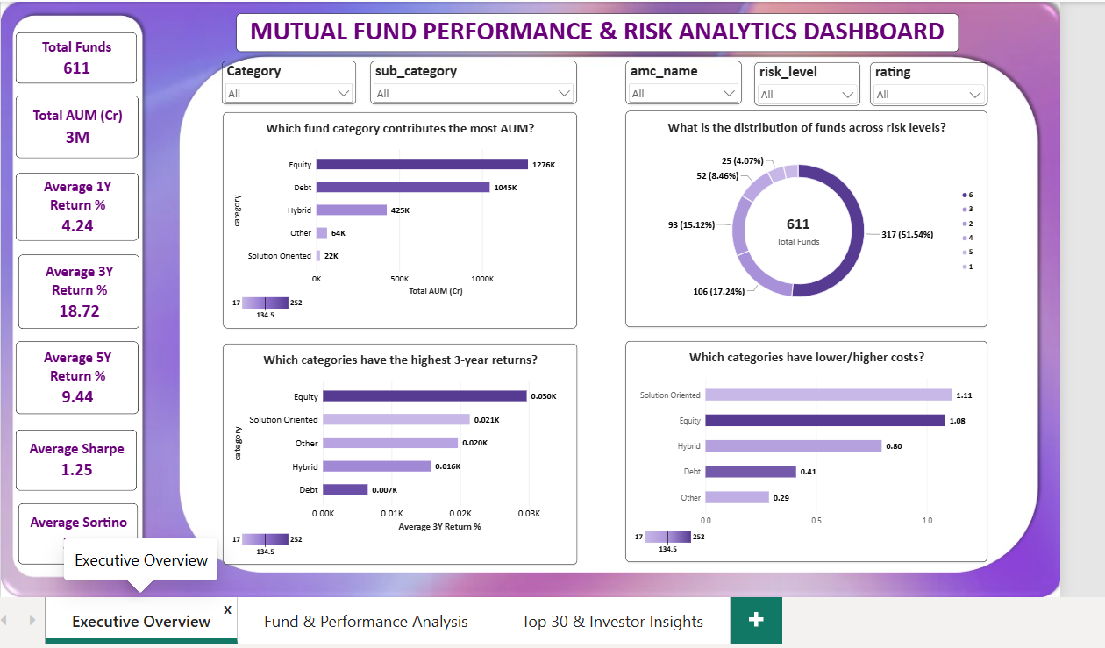
Dashboard Overview

Slide 6
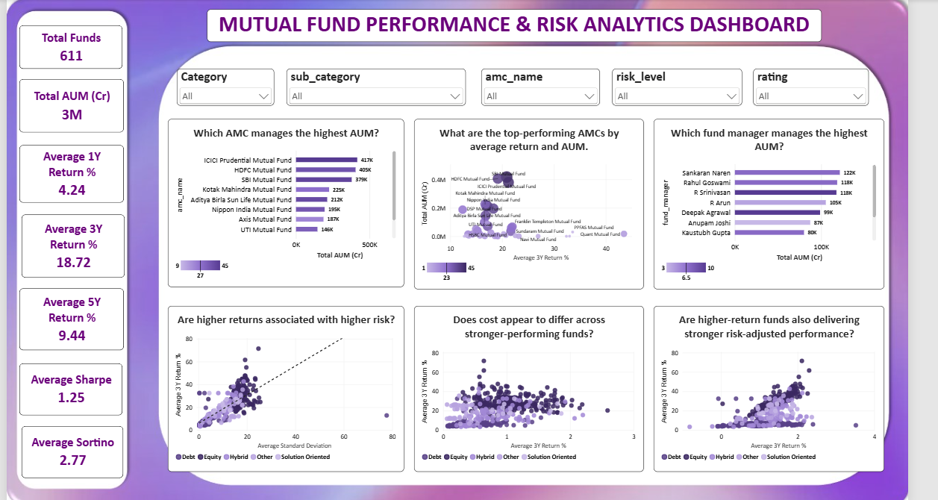

Slide 7
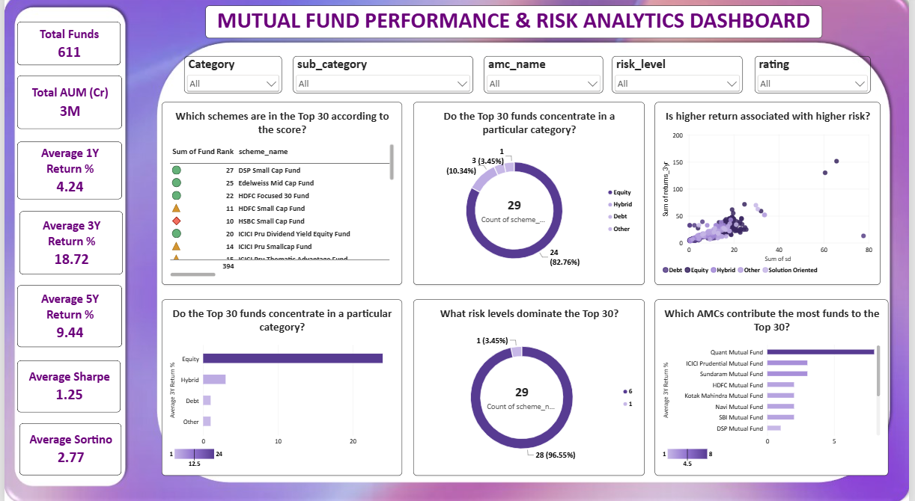

Slide 8
Key Business Insights :
Insight 1 — Category Performance
Equity showed the strongest historical long-term performance, with an average 3-year return of approximately 29.74%, compared with 6.23% for Debt.
Insight 2 — AUM
Equity also had the highest AUM, followed by Debt, indicating that these two categories account for a significant portion of assets in the dataset.
Insight 3 — Risk vs Return
The analysis showed that higher returns are generally associated with higher volatility, highlighting the importance of evaluating risk along with returns.
Insight 4 — Expense Ratio
Debt had the lowest average expense ratio at approximately 0.36%, while Equity had a higher average expense ratio of approximately 1.05%.
Insight 5 — Risk Concentration
Risk Level 6 contained 418 funds, showing that the dataset is heavily concentrated toward the highest risk level.

Slide 9
Business Impact:
These insights can help investment analysts compare categories, identify strong-performing funds, evaluate risk-adjusted performance, understand cost differences and shortlist funds using multiple factors rather than relying only on historical returns.
Recommendations:
I recommend using a multi-factor evaluation approach. Instead of selecting funds based only on returns, the client should consider returns, volatility, Sharpe and Sortino ratios, expense ratio, rating and AUM together.
The Fund Score and ranking can then be used as a screening mechanism to identify funds for further analysis.
Conclusion
Overall, the project successfully transformed mutual fund data into actionable insights. The analysis shows that Equity had the strongest historical long-term performance, but higher returns were generally associated with higher risk. Therefore, a balanced evaluation of return, risk, cost and risk-adjusted performance provides a more reliable approach to fund comparison.

